Slide 1
LECTURE -6 (c)
Hypothesis Testing
Course Instructor
Engr. Naina Said

Slide 2
Hypothesis Testing for Two Independent Means
CSE-422: Data Analytics

Slide 3

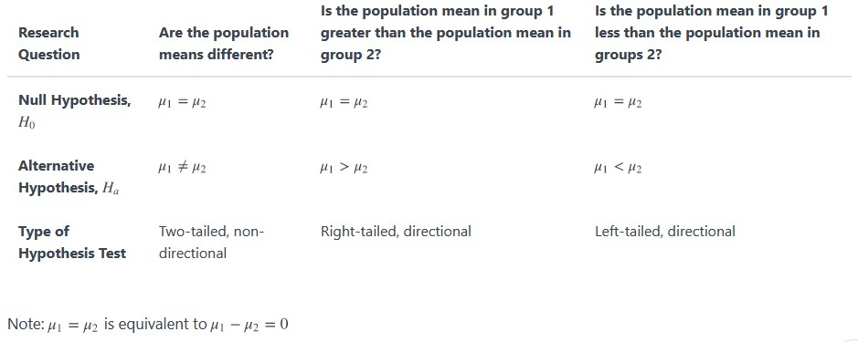
Hypothesis Tests for Independent Means
CSE-422: Data Analytics

Slide 4
Quiz
CSE-422: Data Analytics
Research question: In preschool, are the weights of boys and girls different?
What type of problem is this? Which test will be used? What is the null and alternative hypothesis?

Slide 5






Hypothesis Test for Two Independent Means
CSE-422: Data Analytics

Slide 6
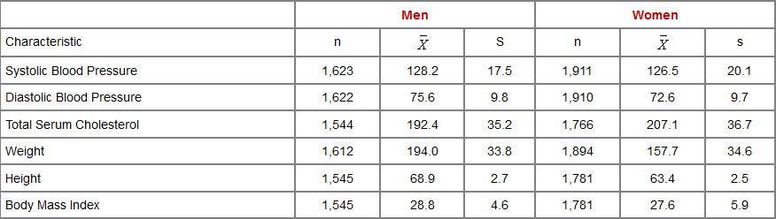
Example 1
CSE-422: Data Analytics
Consider the following data
Is there enough evidence to assess whether there is a statistically significant difference in mean systolic blood pressures between men and women using a 5% level of significance?

Slide 7

STEP 1- State the Null and Alternative hypothesis
CSE-422: Data Analytics

Slide 8
STEP 2- Find Critical Value
CSE-422: Data Analytics
Since both sample sizes > 30 , we can use the z-statistics to find the critical value.
This is a two-tailed test, using a Z statistic and a 5% level of significance. Reject H₀ if Z < -1.960 or is Z > 1.960.

Slide 9



STEP 3- Find Test Value
CSE-422: Data Analytics

Slide 10
Step 4- Make the Decision
CSE-422: Data Analytics
We reject H₀ because 2.66 > 1.960

Slide 11
Step 5- Summarize the Results
CSE-422: Data Analytics
We have enough evidence to support the claim that there is significant difference in mean systolic blood pressures between men and women
This is based on a Type I error rate of 0.05. This means we falsely make the
above claim 5% of the time

Slide 12

Example 2
CSE-422: Data Analytics
A new drug is proposed to lower total cholesterol. A randomized controlled trial is designed to evaluate the efficacy of the medication in lowering cholesterol. Thirty participants are enrolled in the trial and are randomly assigned to receive either the new drug or a placebo.
Is there statistical evidence of a reduction in mean total cholesterol in patients taking the new drug for 6 weeks as compared to participants taking placebo? Take α=0.05

Slide 13
STEP 1- State the Null and Alternative hypothesis

Slide 14
STEP 2- Find Critical Value
CSE-311: Technical Writing
Since both sample sizes < 30 , we can use the t-statistics to find the critical value.
This is a left-tailed test. The critical value for a lower tailed test with df=n1+n2- 2=28 and α=0.05 is -1.701.

Slide 15
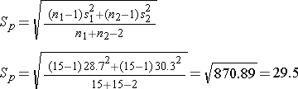

STEP 3- Find Test Value
CSE-311: Technical Writing

Slide 16
Step 4- Make the Decision
CSE-311: Technical Writing
We reject H₀ because -2.92 < -1.701

Slide 17
Step 5- Summarize the Results
CSE-311: Technical Writing
We have enough evidence to support the claim that mean total cholesterol level is lower in patients taking the new drug for 6 weeks as compared to patients taking placebo
This is based on a Type I error rate of 0.05. This means we falsely make the above claim 5% of the time

Slide 18
Hypothesis Testing for Two Paired Means
CSE-311: Technical Writing

Slide 19

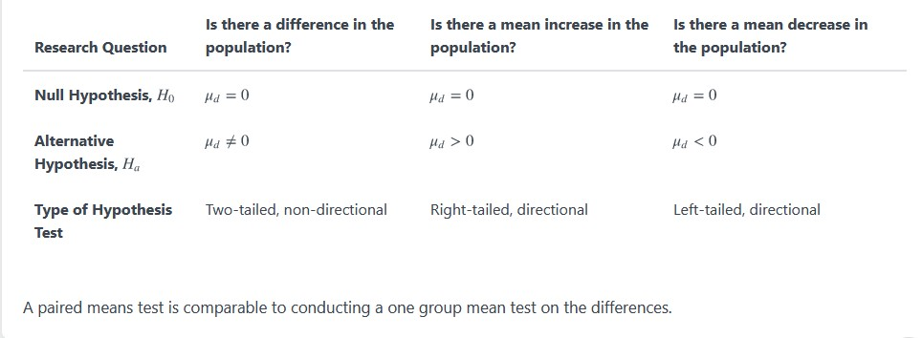
Hypothesis Tests for Paired Means
CSE-422: Data Analytics

Slide 20
Hypothesis Test for Paired Means
CSE-422: Data Analytics
Example : You want to compare the mean weight of same group of people before and after a diet plan.
Null Hypothesis : There is no difference between the mean weight of the people before and after a diet plan.
Alternative Hypothesis : There is a difference between the mean weight of the people before and after a diet plan.

Slide 21
Example
CSE-422: Data Analytics
Research question: Do participants lose weight following a weight-loss intervention?
What type of problem is this? Which test will be used? What is the null and
alternative hypothesis?
Data were collected from one group of participants before and after a weight-loss intervention. Data were paired by participant. Assuming that x₁ is an individual's weight before the intervention and x₂ is their weight at the end of the study, if they lost weight then x₁-X₂ would be a positive number (i.e., greater than 0). Thus, this is a right-tailed test. Because we are testing their mean difference, the parameter that we should write in our hypotheses is μ_{d} where is the mean weight change (before-after) in the population
H₀ : μ_{d} = 0 H₁ : μ_{d} >0

Slide 22
Hypothesis Testing for Two Paired Means
CSE-422: Data Analytics
𝒅^{ഥ} − 𝝁_{𝒅}
𝒔_{𝒅}
𝒏
𝒕 =
If n < 30
𝒅^{ഥ} − 𝝁_{𝒅}
𝒔_{𝒅}
𝒏
𝐳 =
If n >= 30
with degrees of freedom = 𝒅𝒇 = 𝒏 − 𝟏
Where 𝑑^{ҧ} = 𝑠𝑎𝑚𝑝𝑙𝑒 𝑚𝑒𝑎𝑛 𝑜𝑓 𝑑𝑖𝑓𝑓𝑒𝑟𝑒𝑛𝑐𝑒𝑠 = ^{∑𝑑}
𝑛
෌( 𝑑 − 𝑑^{ҧ})2
Standard deviation of the differences: 𝑠_{𝑑} =
^{𝜇}𝑑=0
𝑛 − 1

Slide 23
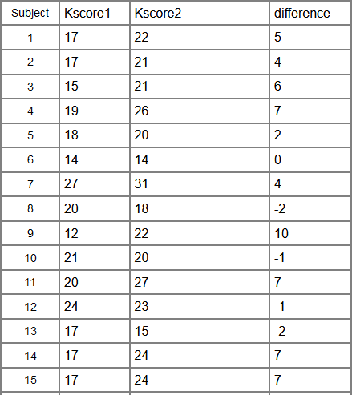
Task
CSE-311: Technical Writing
In the early days of Covid, there was poor knowledge about it among the health care workers. A training
was conducted to improve knowledge and attitudes. Do we have enough
evidence to support the claim that the knowledge
was improved by the training?

